Slide 1
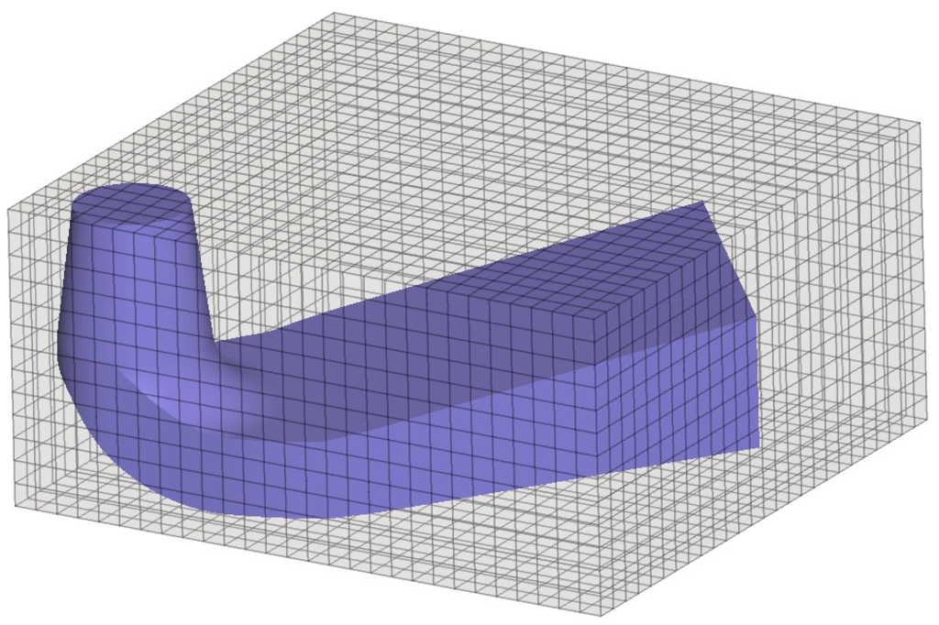

Introduction to
Shubham Chouhan
D23252
ME 615

Slide 2
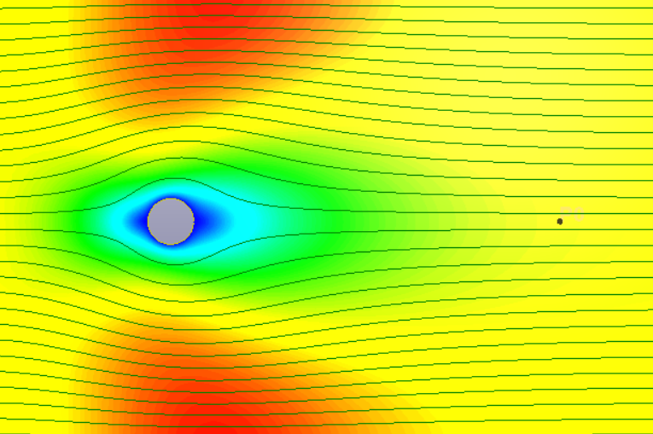
Flow past a 2-D body (ellipse) along its minor axis
External flow problem
OpenFoam open-source software
Shubham Chouhan
D23252

Slide 3
Problem Setup (incompressible flow )
Domain: Rectangular, 15 X 10 units
Obstacle: Ellipse Centered (2.5,5)
Major axis :2 units
Minor axis : 1units
Boundary conditions:
Walls: All four sides of the domain and the ellipse are stationary walls (𝑢=0)
Outlet: Pressure outlet with 𝑝=0

Slide 4




2-D Model Description
Wall, noSlip condition
$$u=1,v=0$$
$$\frac{ⅆp}{ⅆx}=0$$
$$p=0$$
2
10
1
$$\frac{ⅆu}{ⅆx}=0$$
2.5
5
Wall, noSlip condition
15

Slide 5
Solver
icoFoam
specifically designed for incompressible, laminar flow simulations,
Boundary Conditions Compatibility:
Velocity inlet
No-slip walls
Pressure outlet

